Slide 1
SQFLITE & SCROLLING
Prepared by Fares Ahmed & Kerolos Sarwat
Notes:
Revise the Task and tell them what’s better to do this task

Slide 2
Agenda
01
02
03
04
What’s Relational Database
Sqflite
Scrolling
Let’s code

Slide 3
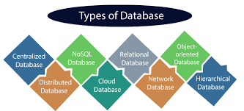

Slide 4
01
What’s SQL

Slide 5
What’s SQL?
Structured Query Language (SQL) is a standardized programming language that is used to manage relational databases and perform various operations on the data in them.

Slide 6
Sqflite vs Hive
Hive is a NoSQL database, meaning it stores data in a schema-less format, often using key-value pairs
Hive is generally considered to be easier to use, especially for simple key-value storage or when dealing with JSON data
Sqflite is a SQLite plugin for Flutter, a relational database management system (RDBMS)
Sqflite requires writing SQL queries and managing database tables explicitly, which might be more complex for developers who are not familiar with SQL or relational databases.

Slide 7
02
Sqflite

Slide 8
Sqflite Package
Sqflite is a Flutter library designed to facilitate the integration of SQLite databases into Flutter applications, offering a convenient way to manage local data storage.
Its purpose is to provide developers with a simple and efficient solution for storing and retrieving data in their Flutter apps, particularly useful for scenarios requiring offline data persistence
SQFlite offers several advantages, including its lightweight nature, efficient asynchronous operations, and reliability in managing SQLite databases

Slide 9
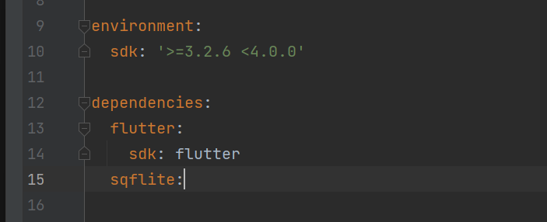
Getting Started
To begin using Sqflite in a Flutter project, developers need to include the Sqflite package as a dependency in their project's pubspec.yaml file.

Slide 10
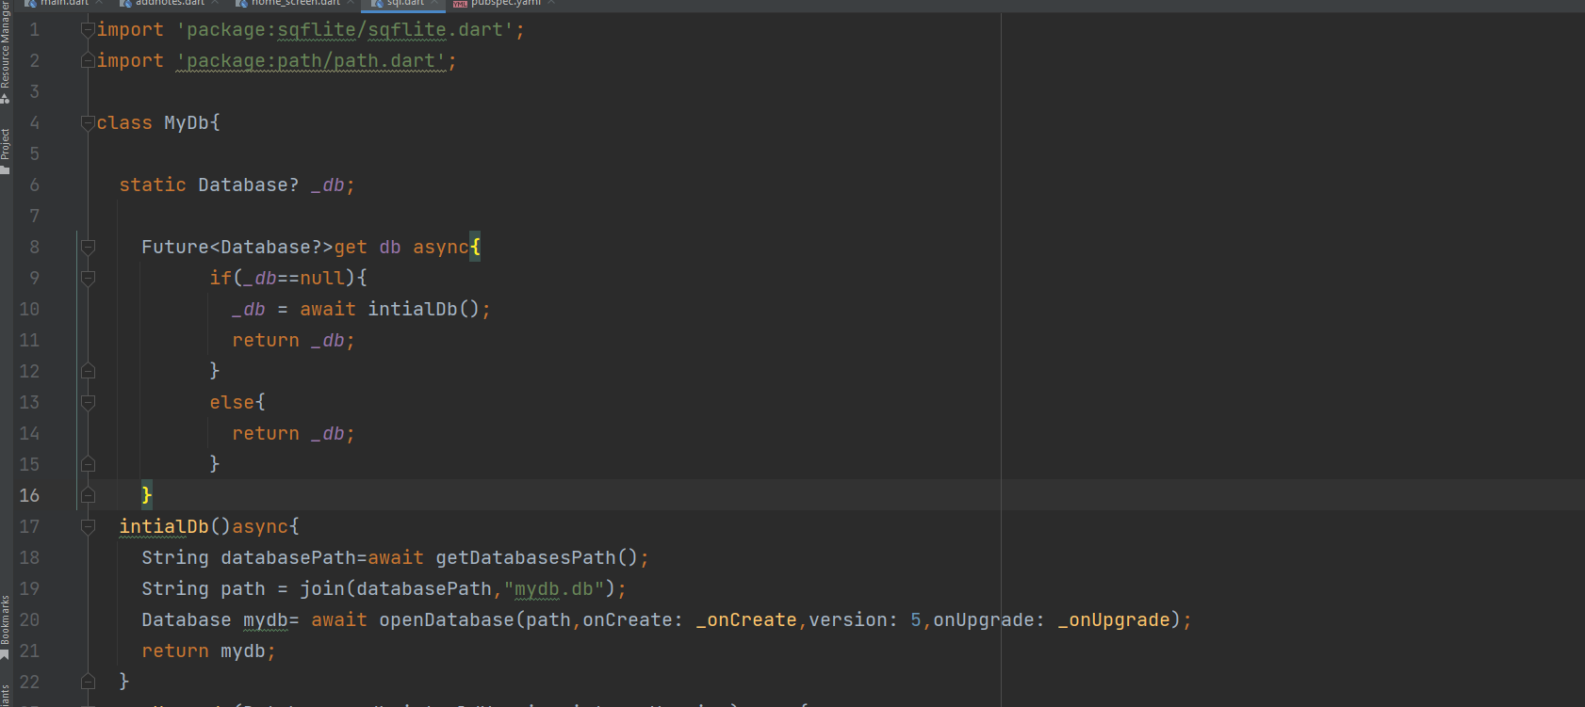
How to initialize?

Slide 11
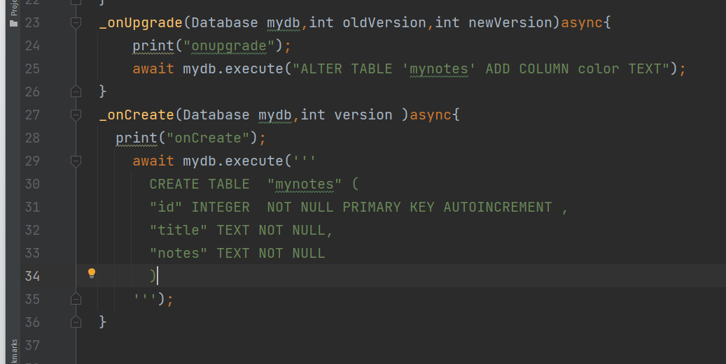
onCreate , onUpgrade

Slide 12
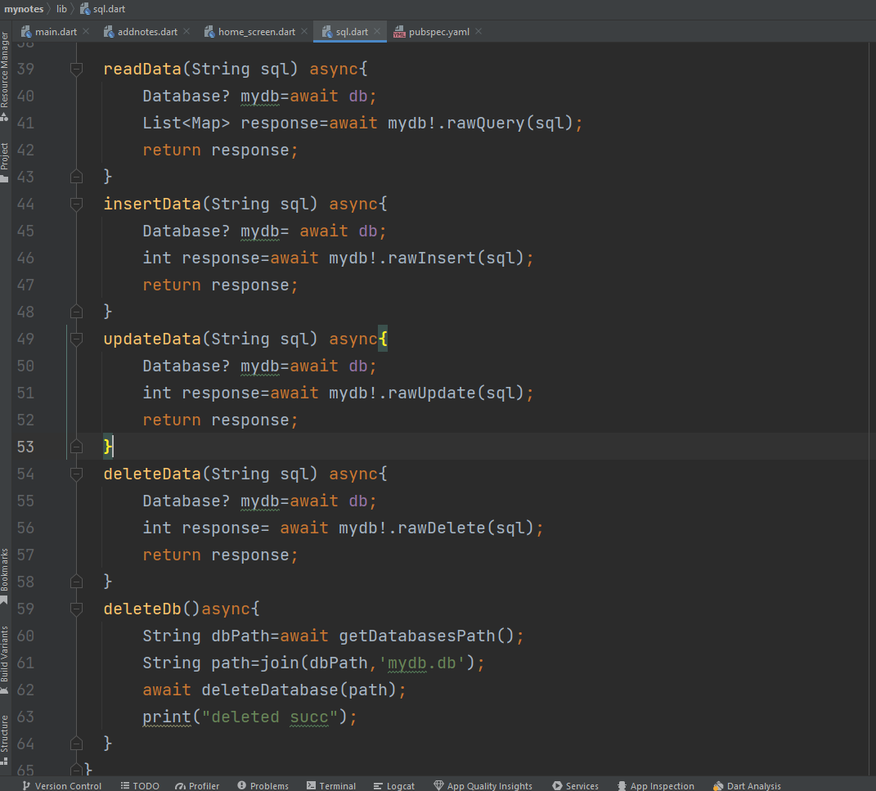
CRUD
(Create / insert )Data
Read
Update
Delete
Notes:
readData() => It returns a list of maps, where each map represents a row in the result
rawInsert() => It returns the last inserted row ID. If an error occurs during insertion, it returns -1
rawUpdate() => It returns the number of rows affected by the update operation
rawDelete() => It returns the number of rows affected by the delete operation

Slide 13
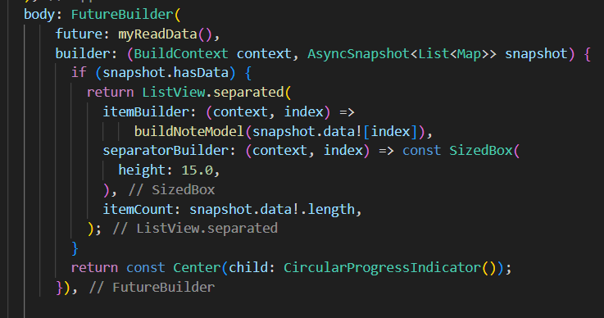
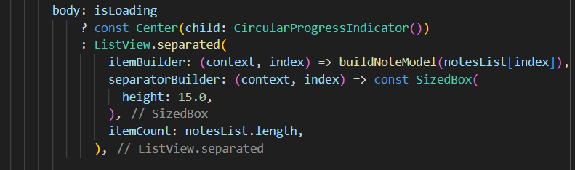
With Flutter Builder
Build UI Layout
With List

Slide 14
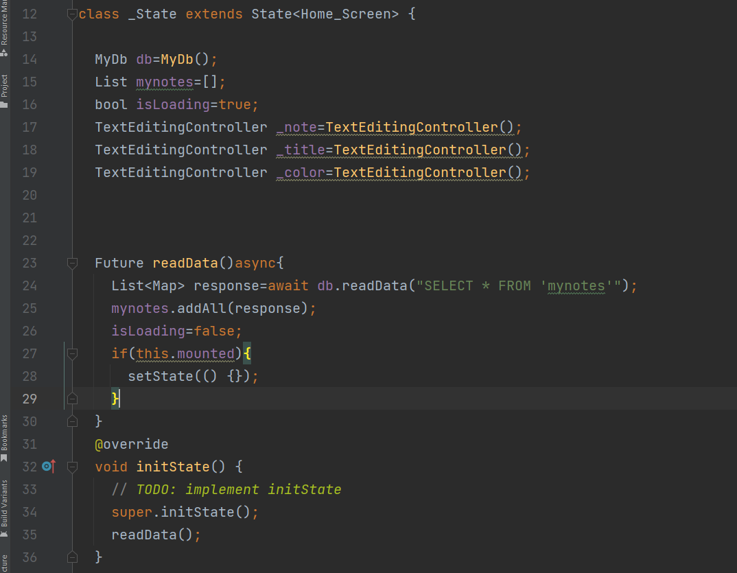
What is next ?
Declare a list that will hold the data
Make an instance from the sql class
Implement a function to retrieve the data from the database

Slide 15
onCreate vs onUpgrade
onCreate
onUpgrade
Is called once when the database is initially created.
It is responsible for defining the database schema and creating the initial structure of the database, such as tables, columns, and constraints.
Is called whenever the database version is increased.
Allows you to make changes to the database schema and manage data migration during app updates.

Slide 16
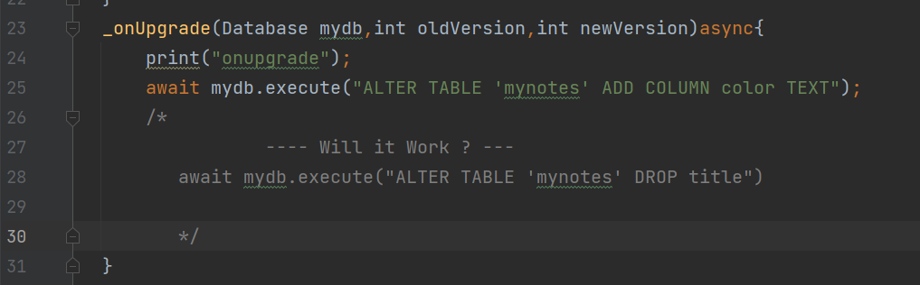
Delete / rename / constraints
SQLite supports a limited subset of ALTER TABLE.
The ALTER TABLE command in SQLite allows the user to rename a table or to add a new column to an existing table.
It is not possible to rename a column, remove a column, or add or remove constraints from a table.

Slide 17
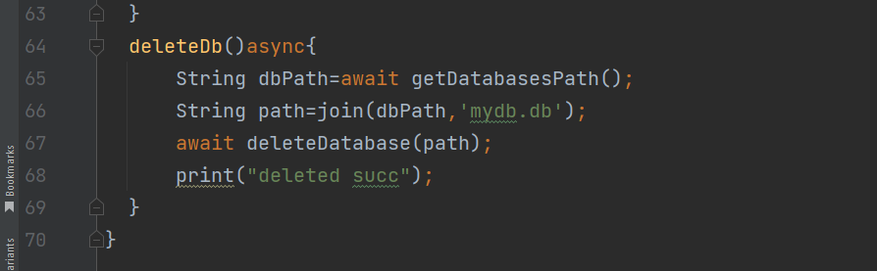
Solution?
You can change the version
Delete the entire database and create new one

Slide 18
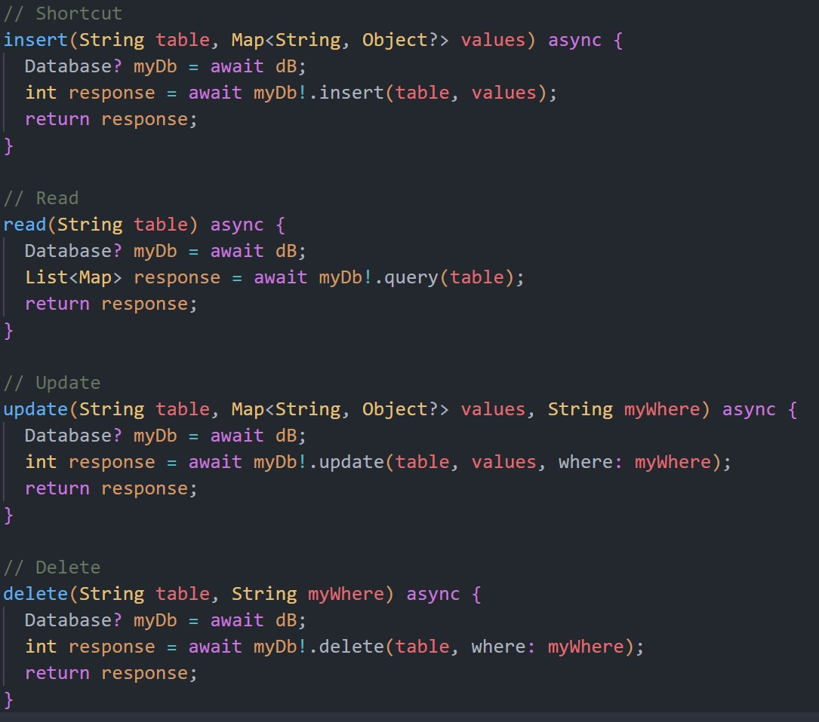
Shortcut

Slide 19
03
Let’s code

Slide 20
04
Scrolling

Slide 21
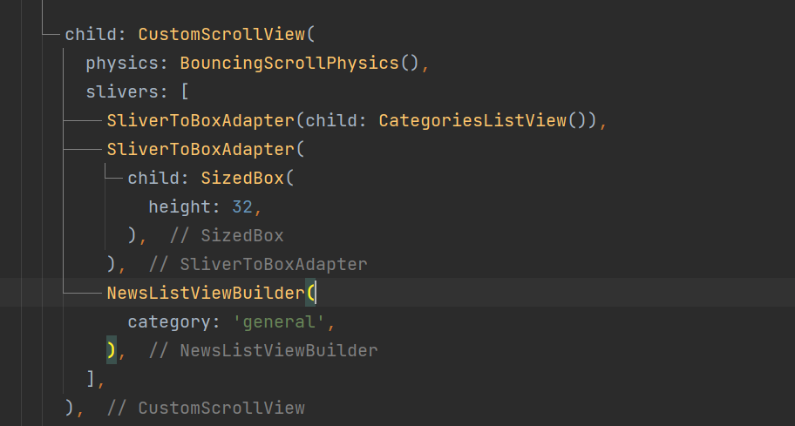
Solution?
Do you remember ListView inside Column problems?

